Slide 1
ADVANCED PROGRAMING Design

Slide 2
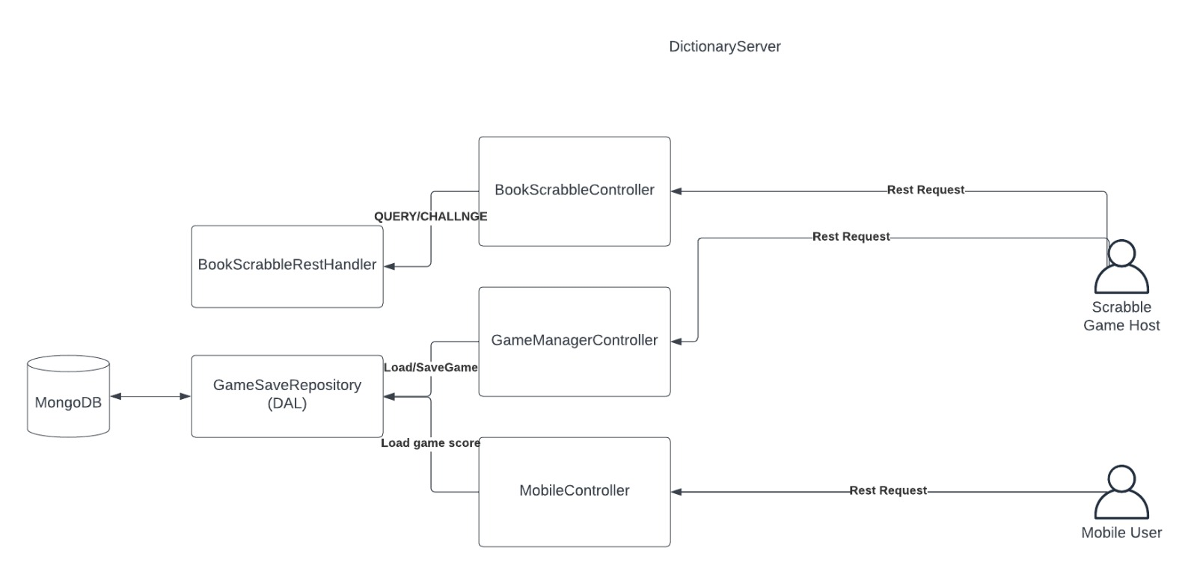

Slide 3
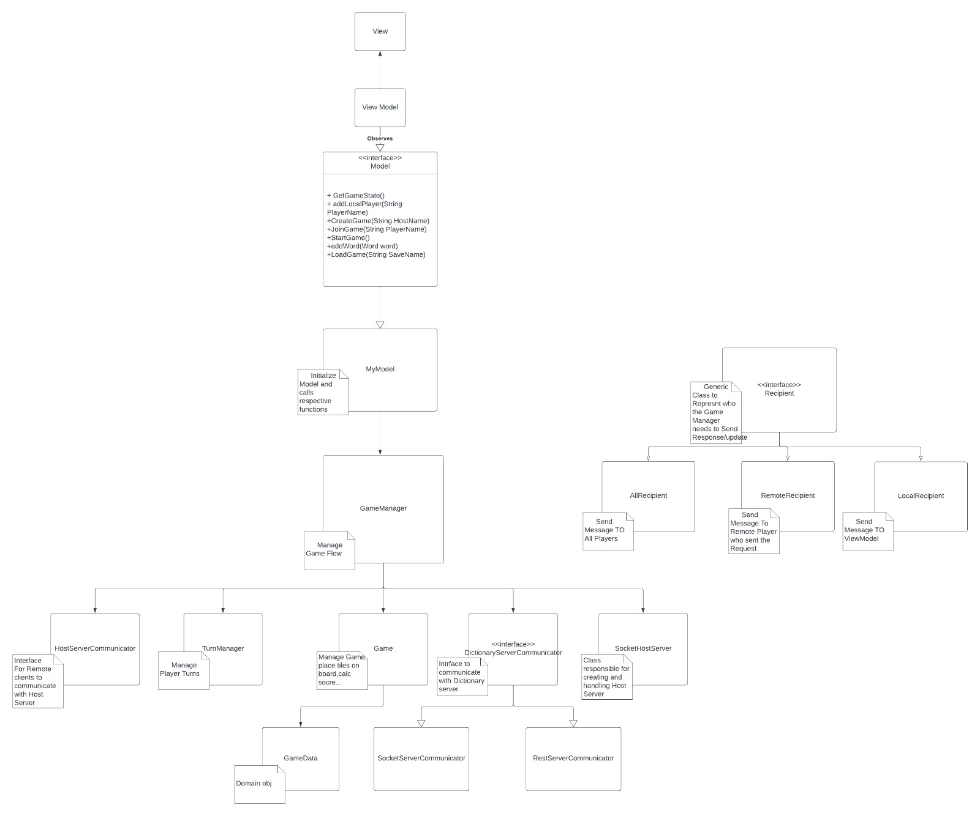

Slide 4
